Slide 1
The Noisy Channel Model of Spelling

Slide 2
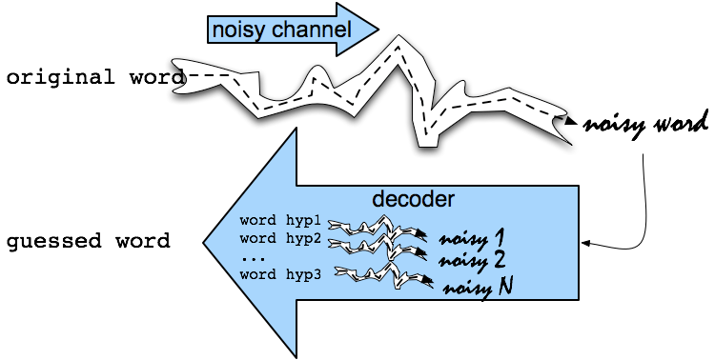
Noisy Channel Intuition
In this model we assume a piece of text (W ) to pass through a noisy channel and we get a garbled text (Y )on the other side of the channel.
Or we can also think of it like an encoder that encodes W to Y.
10

Slide 3
Noisy Channel
Noisy Channel is a probabilistic model
We see an observation x of a misspelled word
Find the correct word w
We are going to find best match for W(where W is that word in the vocabulary which maximizes the probability)
Now we try to model this noisy channel so that we can find the best estimate of W lets call it W' given X .
Or in the case of the second kind of interpretation we can think of it as modelling a decoder that will decode X to W' .
11

Slide 4
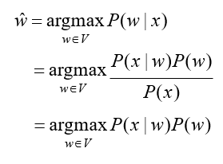
Here P(w) is the language model that tells us the probability of the word being w.
P(x | w) is the noisy channel model that tells us the probability of the original text being w given x.

Slide 5
= argmax P(x | w)P(w)
w∈V
P(w)
Language Model
P(x | w)
Channel Model or Error Model

Slide 6
Candidate generation
Words with similar spelling
Small edit distance to error
Words with similar pronunciation
Small edit distance of pronunciation to error

Slide 7
Damerau-­‐Levenshtein edit distance
Minimal edit distance between two strings, where edits are:
Insertion
Deletion
Substitution
Transposition of two adjacent letters

Slide 8
Non-­‐word spelling error example
acress

Slide 9
Words within 1 of acress
Error | Candidate Correction | Correct Letter | Error Letter | Type
acress | actress | t | - | deletion
acress | cress | - | a | insertion
acress | caress | ca | ac | transposition
acress | access | c | r | substitution
acress | across | o | e | substitution
acress | acres | - | s | insertion
acress | acres | - | s | insertion

Slide 10
Candidate generation
80% of errors are within edit distance 1
Almost all errors within edit distance 2
Also allow insertion of space or hyphen
thisidea → this idea
inlaw → in-law

Slide 11
Language Model
Use any of the language modeling algorithms we’ve learned
Unigram, bigram, trigram
Web-­‐scale spelling correction
Stupid backoff

Slide 12
Unigram Prior probability
STEP 1: Selection of Language Model
Counts from 404,253,213 words in Corpus of Contemporary English (COCA)
word | Frequency of word | P(word)
actress | 9,321 | .0000230573
cress | 220 | .0000005442
caress | 686 | .0000016969
access | 37,038 | .0000916207
across | 120,844 | .0002989314
acres | 12,874 | .0000318463

Slide 13
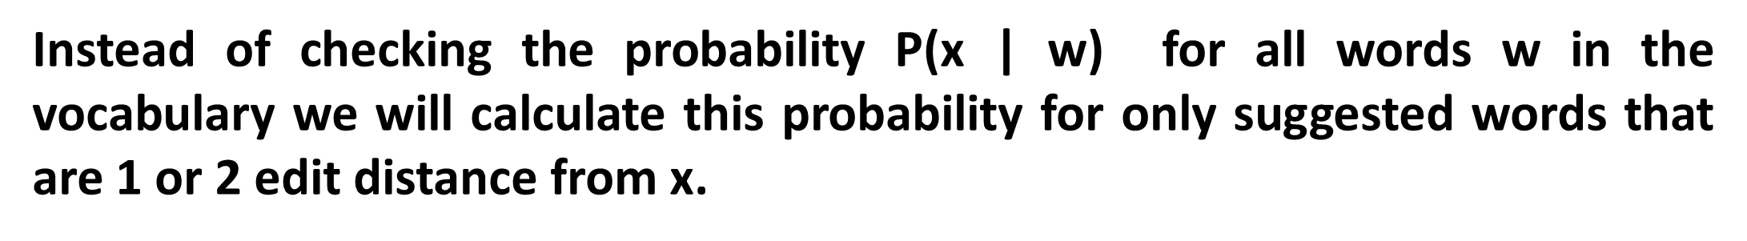
STEP 2: Channel model probability
Error model probability, Edit probability
Misspelled word x = x₁, x₂, x₃… x_{m}
Correct word w = w₁, w₂, w₃,…, w_{n}
P(x|w) = probability of the edit
(deletion/insertion/substitution/transposition)

Slide 14
STEP 3:Computing error probability: confusion matrix
For calculating P(x | w) we first build an error confusion matrix that tells us for a pair of letters how likely an edit (deletion/insertion/substitution/transposition) to happen
del[x,y]: | count(xy | typed | as | x)
ins[x,y]: | count(x | typed | as | xy)
sub[x,y]: | count(x | typed | as | y)
trans[x,y]: | count(xy | typed | as | yx)

Slide 15
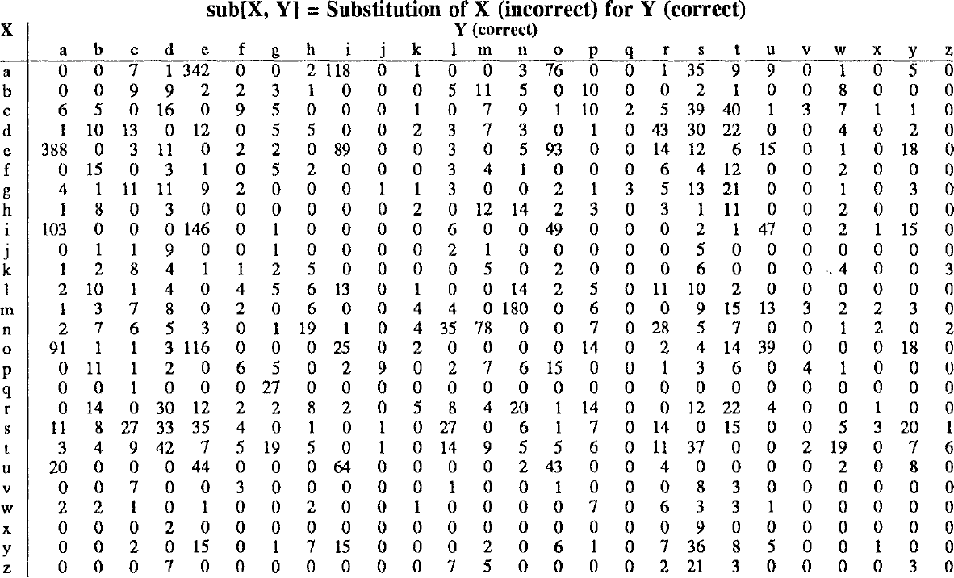
Confusion matrix for spelling errors

Slide 16
STEP 4: Get the probability P(x | w)
Now to get the probability P(x | w) just divide it by the count of the actual characters:
For deletion: deletion(x , w) / count(xw)
For insertion: insert(x , w) / count(w)
For substitution: substitution(x , w) / count(w)
For transposition: transposition(x , w) / count(xw)

Slide 17
Step 5:Calculation for w'
Now once we have the P(x | w) for the candidate suggestions (step 2) we select w’ based on
w' = argmax_w P(x | w)*P(w) .

Slide 18
Channel model for acress
Candidate Correction | Correct Letter | Error Letter | x|w | P(x|word)
actress | t | - | c|ct | .000117
cress | - | a | a|# | .00000144
caress | ca | ac | ac|ca | .00000164
access | c | r | r|c | .000000209
across | o | e | e|o | .0000093
acres | - | s | es|e | .0000321
acres | - | s | ss|s | .0000342

Slide 19
Noisy channel probability for acress
Candidate Correction | Correct Letter | Error Letter | x|w | P(x|word) | P(word) | 10^{9 *}P(x|w)P(w)
actress | t | - | c|ct | .000117 | .0000231 | 2.7
cress | - | a | a|# | .00000144 | .000000544 | .00078
caress | ca | ac | ac|ca | .00000164 | .00000170 | .0028
access | c | r | r|c | .000000209 | .0000916 | .019
across | o | e | e|o | .0000093 | .000299 | 2.8
acres | - | s | es|e | .0000321 | .0000318 | 1.0
acres | - | s | ss|s | .0000342 | .0000318 | 1.0

Slide 20
Noisy channel probability for acress
Candidate Correction | Correct Letter | Error Letter | x|w | P(x|word) | P(word) | 10^{9 *}P(x|w)P(w)
actress | t | - | c|ct | .000117 | .0000231 | 2.7
cress | - | a | a|# | .00000144 | .000000544 | .00078
caress | ca | ac | ac|ca | .00000164 | .00000170 | .0028
access | c | r | r|c | .000000209 | .0000916 | .019
across | o | e | e|o | .0000093 | .000299 | 2.8
acres | - | s | es|e | .0000321 | .0000318 | 1.0
acres | - | s | ss|s | .0000342 | .0000318 | 1.0

Slide 21
Using a bigram language model
“a stellar and versatile acress whose combination of sass and glamour…”
Counts from the Corpus of Contemporary American English with add-­‐1 smoothing
P(actress|versatile)=.000021 P(whose|actress)
P(across|versatile) =.000021 P(whose|across) =
= .0010
.000006
P(“versatile actress whose”) = .000021*.0010
P(“versatile across whose”)
_{x10}-10 _{x10}-10
= 210
= .000021*.000006 = 1

Slide 22
Using a bigram language model
“a stellar and versatile acress whose combination of sass and glamour…”
Counts from the Corpus of Contemporary American English with add-­‐1 smoothing
P(actress|versatile)=.000021 P(whose|actress)
P(across|versatile) =.000021 P(whose|across) =
= .0010
.000006
P(“versatile actress whose”) = .000021*.0010
P(“versatile across whose”)
_{x10}-10
_{x10}-10
= 210
= .000021*.000006 = 1

Slide 23
Spelling Correction and the Noisy Channel
Real-­‐Word Spelling Correction

Slide 24
Real-­‐word spelling errors
• | …leaving in about fifteen minuets | to go to her | house.
• | The design an construction of the | system…
• | Can they lave him my messages?
• | The study was conducted mainly be | John Black.
25-­‐40% of spelling errors are real words
Kukich 1992
33

Slide 25
Solving real-­‐world spelling errors
For each word in sentence
Generate candidate set
the word itself
all single-­‐letter edits that are English words
words that are homophones
Choose best candidates
Noisy channel model
Task-­‐specific classifier
34

Slide 26
Noisy channel for real-­‐word spell correction
Given a sentence w₁,w₂,w₃,…,w_{n}
Generate a set of candidates for each word w_{i}
Candidate(w₁) = {w₁, w’₁ , w’’₁ , w’’’₁ ,…}
Candidate(w₂) = {w₂, w’₂ , w’’₂ , w’’’₂ ,…}
Candidate(w_{n}) = {w_{n}, w’_{n} , w’’_{n} , w’’’_{n} ,…}
Choose the sequence W that maximizes P(W)

Slide 27




Noisy channel for real-­‐word spell correction
two
of
thew
...
to
threw
tao
off
thaw
too
on
the
two
of
thaw
36

Slide 28







Noisy channel for real-­‐word spell correction
two
of
thew
...
to
threw
tao
off
thew
too
on
the
two
of
thaw
37

Slide 29
Simplification: One error per sentence
Out of all possible sentences with one word replaced
w₁, w’’₂,w₃,w₄
w₁,w₂,w’₃,w₄
w’’’₁,w₂,w₃,w₄
…
two off thew two of the too of thew
Choose the sequence W that maximizes P(W)

Slide 30
Where to get the probabilities
Language model
Unigram
Bigram
Etc
Channel model
Same as for non-­‐word spelling correction
Plus need probability for no error, P(w|w)

Slide 31
Probability of no error
What is the channel probability for a correctly typed word?
P(“the”|“the”)
Obviously this depends on the application
.90 (1 error in 10 words)
.95 (1 error in 20 words)
.99 (1 error in 100 words)
.995 (1 error in 200 words)

Slide 32
Peter Norvig’s “thew” example
x | w | x|w | P(x|w) | P(w) | 10⁹ P(x|w)P(w)
thew | the | ew|e | 0.000007 | 0.02 | 144
thew | thew |  | 0.95 | 0.00000009 | 90
thew | thaw | e|a | 0.001 | 0.0000007 | 0.7
thew | threw | h|hr | 0.000008 | 0.000004 | 0.03
thew | thwe | ew|we | 0.000003 | 0.00000004 | 0.0001

